Slide 1


Dodgy Coders
Nikhil Khedkar
Sandip Sutariya
Siddhiraj panatoji
Swati shinde

Slide 2
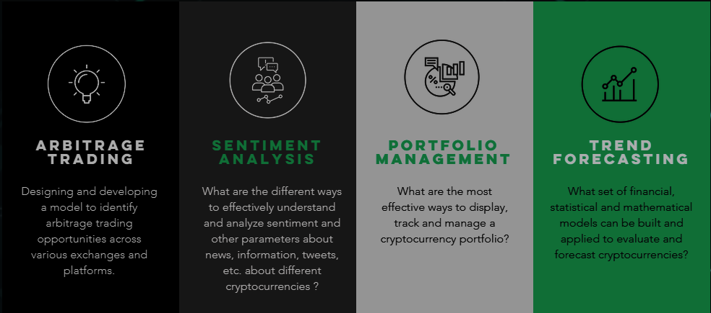
Problem Statement
To better understand and trade cryptocurrencies using financial modelling and forecasting, big data analytics, artificial intelligence & machine learning.
Hacked during “The Ultimate Crypto Challenge”
2

Slide 3
Solution Approach
Data Source
Data API
Filter Criteria
Text Sentiment Score
Sentiment Influence Score
Cryptocurrency Price
Create Model
Fine Tune
Try!
Hacked during “The Ultimate Crypto Challenge”
3

Slide 4
Roadmap
We are Here!
Live Data – Twitter feed
Mid-term
Integration with Portfolio Mgmt.
Long-term
Model BTC Price v/s Traditional Investment Avenues (Gold, Stock Markets, Property Prices)
Text Sentiment Score – Polarity and Intensity
Comprehensive Sentiment Influence Score
Model – BTC Price v/s Sentiment Influence Score
Add support for other cryptocurrencies
BTC Trade Automation
BTC Trade suggestions
Hacked during “The Ultimate Crypto Challenge”
4

Slide 5
Differentiators
Comprehensive Sentiment Influence Score → Not just the “Text sentiment”, but also weightages for User’s “Influential ability”
Actionable insights
Designed as reusable components – for further strengthening and extension for other cryptocurrencies
Artifacts
Code Repo → https://github.com/Swati0619/hack2018
Solution Wiki → https://github.com/Swati0619/hack2018/blob/master/README.md
Thank You!
Hacked during “The Ultimate Crypto Challenge”
5

